Slide 1
Name:

Slide 5
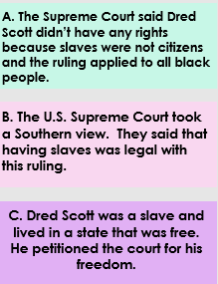
Write the Issue, Ruling and Outcome on page 10

Slide 6
Directions: Drag and Drop the descriptions UNDER the correct section of the Supreme Court Case of Dred Scott
A. The Supreme Court said Dred Scott didn’t have any rights because slaves were not citizens and the ruling applied to all black people.
B. The U.S. Supreme Court took a Southern view. They said that having slaves was legal with this ruling.
C. Dred Scott was a slave and lived in a state that was free. He petitioned the court for his freedom.

Slide 9
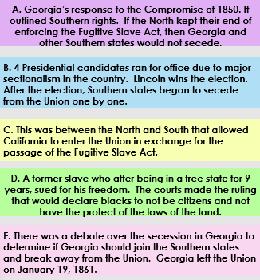
Match the definitions with the causes on page 13

Slide 10
Directions: Drag and Drop the descriptions UNDER the correct section being described of the Events leading to the Civil War.
A. Georgia’s response to the Compromise of 1850. It outlined Southern rights. If the North kept their end of enforcing the Fugitive Slave Act, then Georgia and other Southern states would not secede.
B. 4 Presidential candidates ran for office due to major sectionalism in the country. Lincoln wins the election. After the election, Southern states began to secede from the Union one by one.
C. This was between the North and South that allowed California to enter the Union in exchange for the passage of the Fugitive Slave Act.
D. A former slave who after being in a free state for 9 years, sued for his freedom. The courts made the ruling that would declare blacks to not be citizens and not have the protect of the laws of the land.
E. There was a debate over the secession in Georgia to determine if Georgia should join the Southern states and break away from the Union. Georgia left the Union on January 19, 1861.

Slide 11
Directions: #1-5 Drag and Drop the descriptions UNDER the term being described.
A. On January 19, 1861, this state officially seceded from the United States.
B. African American who sued the state of Missouri for his freedom. The hearing of which went all the way to the U.S. Supreme Court and the ruling stated that African Americans were not citizens of the United States and had no rights.
C. Presidential election with the candidate Abraham Lincoln wanting to end slavery. Caused southern states to hold conventions on Secession.
D. Convention was held in 1861 in Milledgeville Georgia voted to leave the Union.
E. Stephen Alexander, representative of Georgia encouraged the passing of the Compromise of 1850 which is credited with delaying the outbreak of Civil War.
Directions: #6-8 Drag and drop the green rectangle and place it over the answer that BEST completes the questions.

Slide 12
Directions: #1-5 Drag and Drop the descriptions UNDER the term being described.
A. On January 19, 1861, this state officially seceded from the United States.
B. African American who sued the state of Missouri for his freedom. The hearing of which went all the way to the U.S. Supreme Court and the ruling stated that African Americans were not citizens of the United States and had no rights.
C. Presidential election with the candidate Abraham Lincoln wanting to end slavery. Caused southern states to hold conventions on Secession.
D. Convention was held in 1861 in Milledgeville Georgia voted to leave the Union.
E. Stephen Alexander, representative of Georgia encouraged the passing of the Compromise of 1850 which is credited with delaying the outbreak of Civil War.
Directions: #6-8 Drag and drop the green rectangle and place it over the answer that BEST completes the questions.

