Slide 1
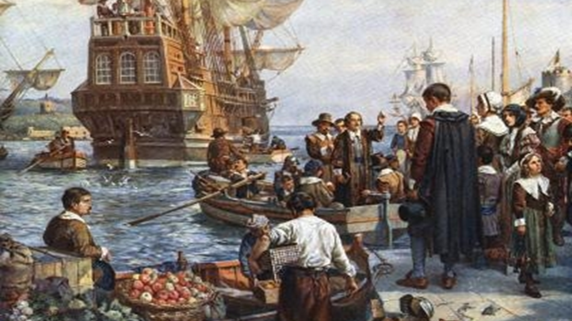
Exploration and Settlement Unit 2 Week 9
Bell-Ringer – What was the name of Georgia’s first Royal Governor?
Notes:
Quick Review

Slide 2
Weekly standards & Learning Target
Standard
Learning Target
SS8H2 Analyze the colonial period of Georgia’s history.
d. Explain the transition of Georgia into a royal colony with regard to land ownership, slavery, alcohol, and government.
e. Give examples of the kinds of goods and services produced and traded in colonial Georgia.
I can explain the transition from the Trustee colony to a Royal Colony, and give examples of goods and services produced and traded.

Slide 3
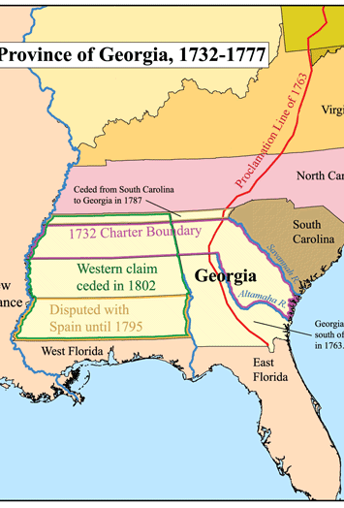
Introduction:
The Royal period began in 1752, Georgia Trustees surrendered Georgia's charter to the British government.
Is there conflict in government today? If so, what are some examples?

Slide 4
How did Georgia become a royal colony?
The period after Georgia returned its charter and became a British royal colony until the end of the American Revolution was a time of unrest and turmoil in Georgia and in the other colonies.
In 1752, Georgia ceased to be a proprietary colony (governed by trustees) and became a royal colony (governed by the crown). The trustees were frustrated with the lack of economic and social successes. They chose to return the colony to the king, a year before the Charter of 1732 expired.

Slide 5
ROYAL COLONY
LAND OWNERSHIP
Colonists allowed to own and sell more land
Large farms with slave labor strengthened GAs economy.
Social classes developed
Border of Georgia increased south to St. Mary’s River and west to the Mississippi River
SLAVERY
Only wealthy could own slaves
Worked on rice farms
Planters bought more and more land
Ultimately, changed the dynamic of the colony and tremendously increased the population and helped the economy
GOVERNMENT
Royal governors appointed by King (John Reynolds, Henry Ellis, James Wright)
Trustee laws repealed
bi-cameral legislature
white males with property could vote
colonists had more freedom: self-government
court system to settle disputes
Notes:
Review W.R.I.S.T

Slide 6
Continue Week 9 Interactive Notebook
Notes:
Instructional Approach-
Read aloud/Scaffold

