Slide 1
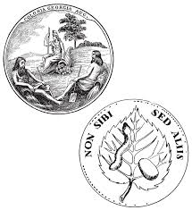
IntrodUCtion
List 10 facts you can remember during unit 2. You have 3 minutes! (words, phrases, etc.)

Slide 2
Weekly Standard & Learning Target
Weekly Standard
Learning Target
SS8H2 Analyze the colonial period of Georgia’s history.
a) Explain the importance of the Charter of 1732, including the reasons for settlement (philanthropy, economics, and defense).
b) Analyze the relationship between James Oglethorpe, Tomochichi, and Mary Musgrove in establishing the city of Savannah at Yamacraw Bluff.
d. Explain the transition of Georgia into a royal colony with regard to land ownership, slavery, alcohol, and government.
e. Give examples of the kinds of goods and services produced and traded in colonial Georgia.
I can analyze the colonial period of Georgia's history.

Slide 3
Review Day!!!
https://create.kahoot.it/details/beach-ss8h1-gse-european-exploration/27ad90de-a143-488e-b648-db3ce66eb669
https://create.kahoot.it/details/colonial-era-georgia-review-trustee-period/92ca26b8-db7c-40df-8067-125f2343bf35
https://create.kahoot.it/details/gse-ss8h2/211affef-5a28-46b9-a902-4bcb85361b18

Slide 4
Reminders & Interactive notebook
Quizlet is on blog – if you have not studied it yet… please do so tonight!!!
Test tomorrow (40 questions, 60% of grade)
You will only have the class period.
If you have not finished the interactive notebook, make sure it is finished.

