Slide 1
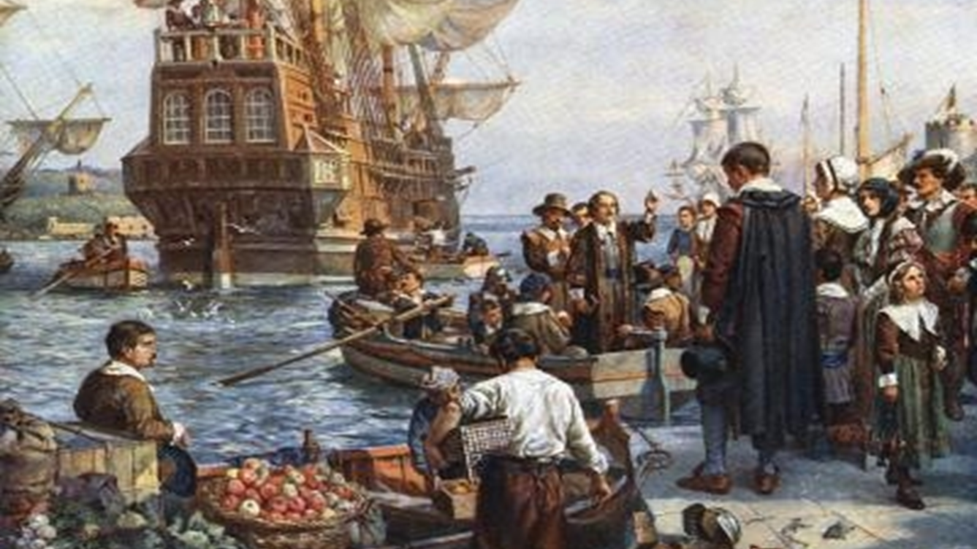
Exploration and Settlement Unit 2 Week 9
Bell-Ringer - Define malcontent in your SS notebooks in your own words.
Hint: Malcontent comes from the Latin root mal means “bad,” or “ill” and the word content, meaning satisfied
Notes:
Quick Review

Slide 2
Weekly Standards & Learning Target
Weekly Standard
Learning Target
SS8H2 Analyze the colonial period of Georgia’s history.
c. Evaluate the role of diverse groups (Jews, Salzburgers, Highland Scots, and Malcontents) in settling Georgia during the Trustee Period.
I can explain the role of diverse groups in settling Georgia during the Trustee Period.

Slide 3
COMPARING TWO COLONIES
What were the rules & regulations outlined by the Charter and the Trustees?
ROYAL COLONY
SLAVERY WAS ALLOWED
TRADE RUM WITH INDIANS
NO LAND LIMITS
FEMALES COULD INHERIT LAND
COULD GROW COTTON, RICE, AND TOBACCO
VERY PROFITABLE
SOUTH CAROLINA
GEORGIA
No slavery
No rum
No lawyers and no gambling
Land limits (could not buy or sell land)
Female could not inherit land
Struggled to make money (forced to grow mulberry trees and indigo plants)
Trading with Indians required a license.
Notes:
TRUSTEE COLONY
NO SLAVERY
NO RUM
No lawyers
No Gambling
LAND LIMITS (Could not buy or sell)
FEMALE COULD NOT INHERIT LAND
FORCED TO GROW MULBERRY TREES, and Indigo Plants
STRUGGLED TO MAKE MONEY
Trading with the Indians in GA required a license

Slide 4
Who were the Malcontents?
Many of Georgia's original settlers came with monetary aid from the Trustees; however, many others arrived without assistance and thus did not have the same loyalty to the colony's founders. These people were known as Malcontents.
Their South Carolina neighbors, who had large amounts of land, slaves and rum, were doing well. They were growing rice, cotton, and tobacco, and their success was due, in part, to the use of slave labor. The Malcontents could afford to purchase slaves and vast tracts of land, they felt the policies of the Trustees prevented them from realizing their economic potential.
Notes:
https://www.georgiaencyclopedia.org/articles/history-archaeology/malcontents

Slide 5
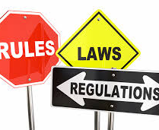
Class Activity
Begin work on Interactive Notebook (must be completed by start of class Thursday)

