Slide 1
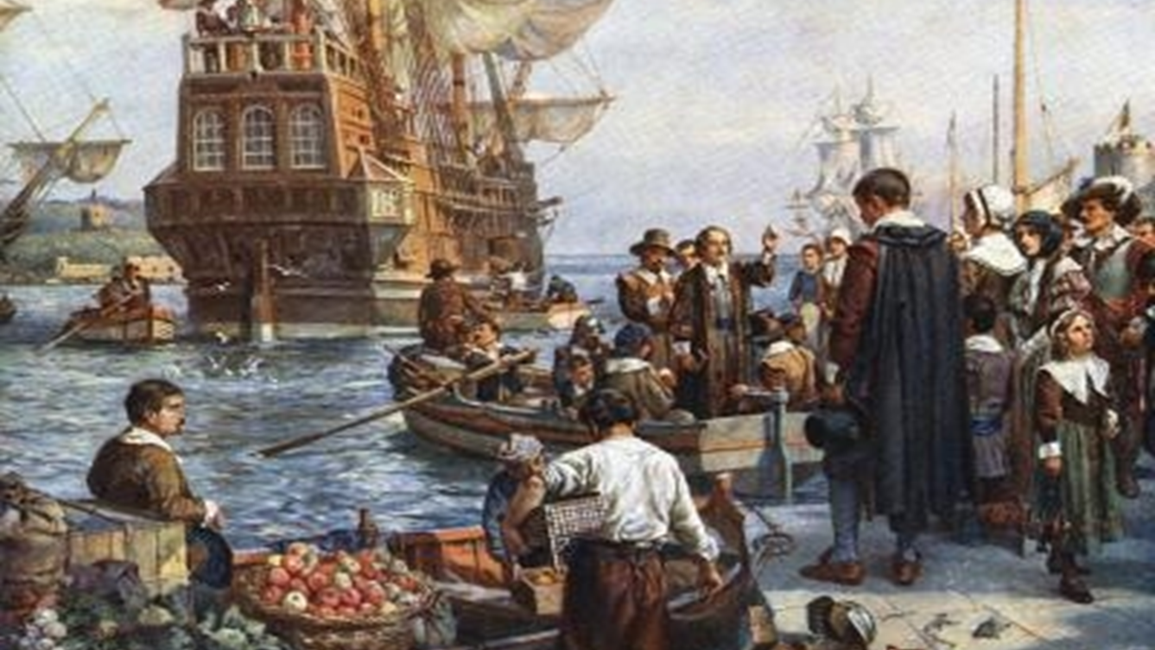
Exploration and Settlement Unit 2 Week 8
Notes:
Quick Review

Slide 2
Weekly Standards & Learning Targets
Weekly Standards
Learning Targets
SS8H2 Analyze the colonial period of Georgia’s history.
a) Explain the importance of the Charter of 1732, including the reasons for settlement (philanthropy, economics, and defense).
b) Analyze the relationship between James Oglethorpe, Tomochichi, and Mary Musgrove in establishing the city of Savannah at Yamacraw Bluff.
I can explain the reasons for settlement of Georgia listed in the Charter of 1732 and the role of the diverse groups.
I can analyze the relationship between James Oglethorpe, Tomochichi, and Mary Musgrove.

Slide 3
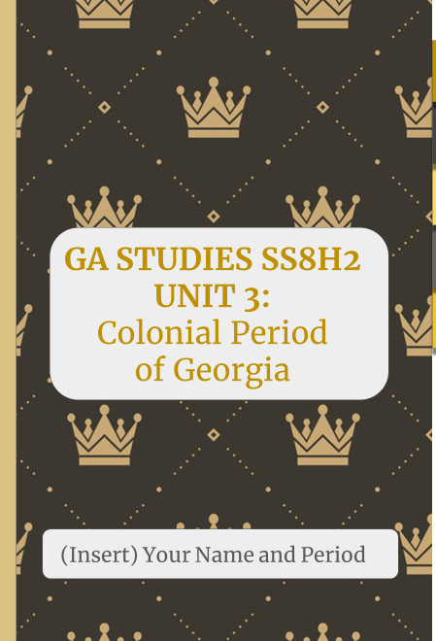
Reminders
After you finish the quiz, please go to your week 8 assignment tab, and pull up the following assignment; SS8Hc Interactive Notebook.
Due by Friday, October 16th
If you have not completed your Flipgrid Assignment from week 7, please remember it is due by Wednesday, October 14th.
Q1 Grades are finalized Friday, Oct. 16th.

Slide 4
Unit 2 part 2 formative
You must complete the assessment by the end of class.

Slide 5
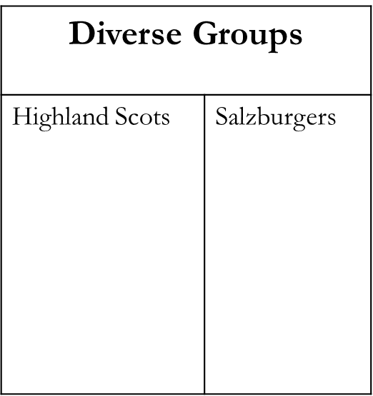
Exploration and Settlement Unit 2 Week 8 – Day 2
Title
Date
Please have your notebook and a pen/pencil with you.
Title today’s notes: Diverse Groups Roles in Settling Georgia (10/15/2020)
Notes:
Quick Review

Slide 6
Reminders
Both of these are due before 8:30 AM Friday at the latest if you do not want a 0.
Unit 2 Part 2 Summative – Was due Tuesday (found in Assess)
Flipgrid (link is found on my blog in “Classwork & Powerpoints” Week 7
Week 8 Interactive Notebook due Friday – found in CTLS under resources

Slide 7
Weekly Standards & Learning Targets
Weekly Standards
Learning Targets
SS8H2 Analyze the colonial period of Georgia’s history.
c. Evaluate the role of diverse groups (Jews, Salzburgers, Highland Scots, and Malcontents) in settling Georgia during the Trustee Period.
I can explain the role of diverse groups in the settling of Georgia during the Trustee Period.
REMINDER – The Trustee Period is what we call the time in which James Oglethorpe and his Trustees were in charge of Georgia.

Slide 8
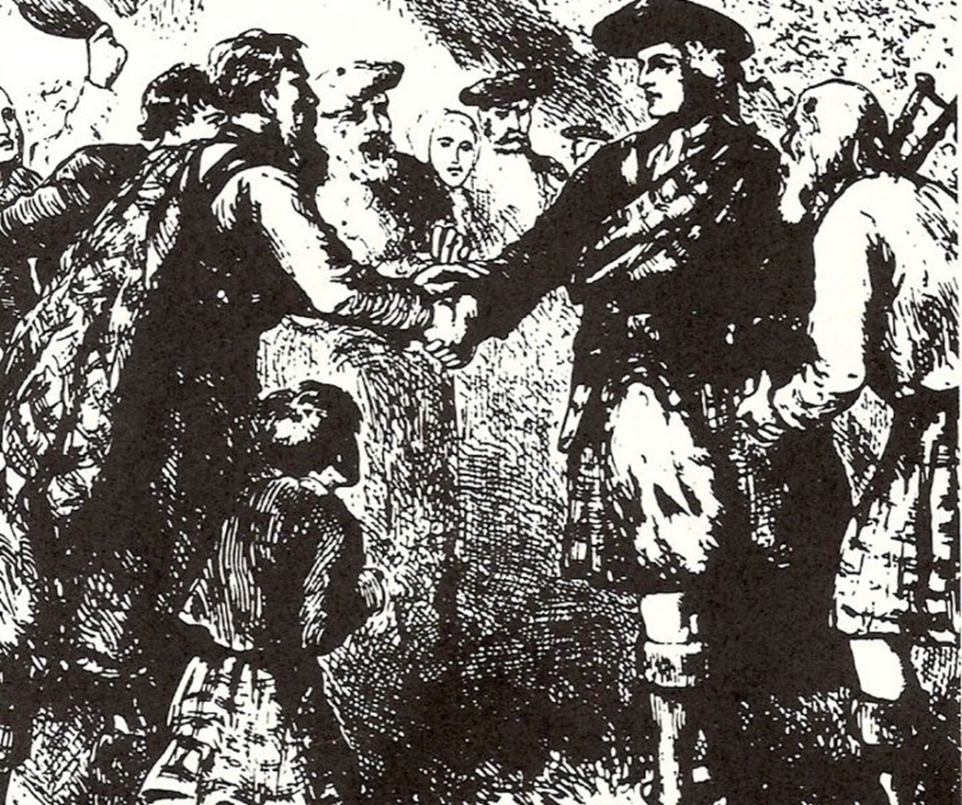
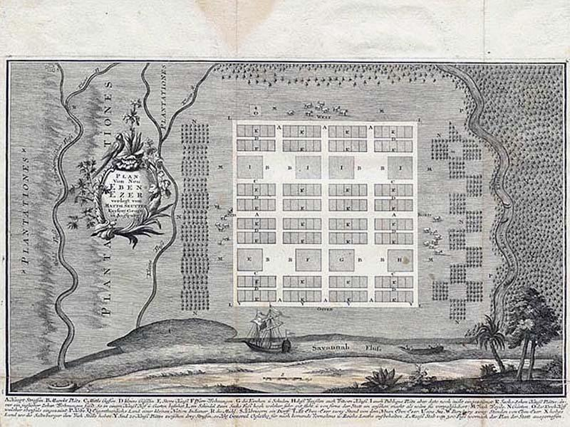
Oglethorpe greeting the Highlanders
Introduction
Identify the following in each video
Who were they?
What reason did they seek the Georgia Colony?
When did they arrive?
Where are they from?
Why were they important to the development of Georgia?
New Ebenezer, located on the bluffs above the Savannah River
Notes:
Instructional Approach-

Slide 9
ROLE OF THE SALZBURGERS AND HIGHLAND SCOTS
WHO: SALZBURGERS
WHAT: Escaped religious persecution from Catholic-run Germany/Austria.
WHEN: 1734
WHERE: Built the New town of Ebenezer; Northwest of Savannah along the Savannah River.
WHY: They helped the colony of Georgia because they were skilled laborers. The only group successful with silk, first orphanage, and created first Sunday school.
WHO: HIGHLAND SCOTS
WHAT: Group of soldiers from Scotland who helped colonize Georgia and defend the Colony from the Spanish threat in Florida; recruited by Oglethorpe.
WHEN: 1736
WHERE: Built the town and fort called Darién along the Altamaha River and raised cattle and timber.
WHY: They were instrumental in defeating the Spanish during a battle known as the “Battle of Bloody Marsh” and ended the Spanish threat.

Slide 10
Week 8 Interactive Notebook
Reminder – Due tomorrow!!!
Notes:
Instructional Approach-
Read aloud/Scaffold

Slide 11
Padlet Work Session
https://padlet.com/terenceburger/GeorgiaGroups
Create a drawing comparing and contrasting the roles and importance of the Salzburgers & Highland Scots in settling Georgia. You can just take a picture of your drawing, save it to your computer, and post it in the Padlet. PLEASE MAKE SURE YOU WRITE YOUR NAME ON THE PADLET TO GET CREDIT!!!

Slide 12
Closing:
In the chat, write a sentence of what you have learned and a question for class.
You can’t exit the Zoom until you have completed the closing.

