Slide 1
Georgia’s Beginnings Unit 1 Week 4
Please grab your notebook and a pen.

Slide 2
Weekly Standard & Learning Target
Weekly Standard
SS8H1 Evaluate the impact of European exploration and settlement on American Indians in Georgia.
a. Describe the characteristics of American Indians living in Georgia at the time of European contact; to include culture, food, weapons/tools, and shelter.
Learning Target
Students will be able to describe the characteristics of Native American Indians living in Georgia at the time of European contact.

Slide 3
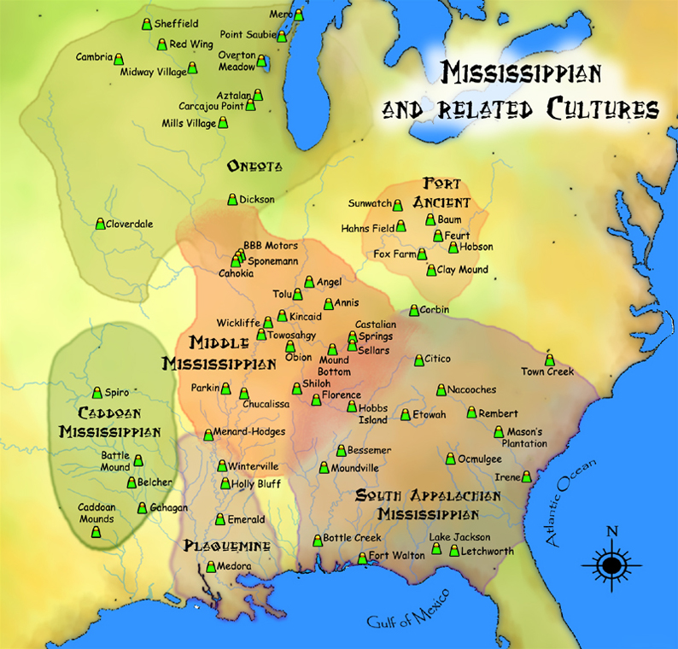
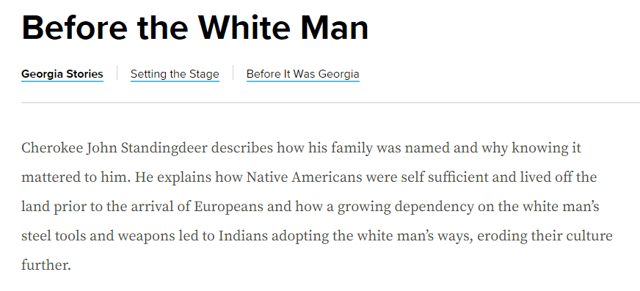
Day 1
Video Link
Notes:
Day 1 Introduction
Video- https://www.gpb.org/georgiastories/stories/cultures_blend

Slide 4
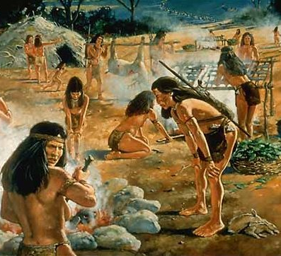
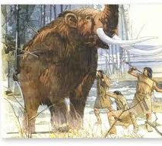
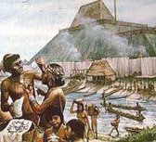
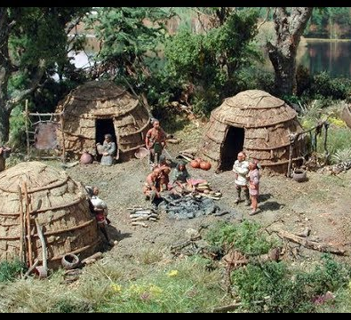
Examine the pictures
After you examine the images, list artifacts that might have been left by the people in the pictures. What clues would those artifacts tell us about the people who left them?
Notes:
Day 1 Introduction

Slide 5
PUT THIS IN YOUR NOTEBOOK
The chronological (oldest to newest) order of the ancient cultures in Georgia:
Paleo (oldest)
Archaic
Woodland
Mississippian (newest)
came in contact with European explorers

Slide 6
SS8H1a
Step 1: Re-Create the two Venn Diagram Charts to the left in your notebook
Step 2: Explore the Early Native American Cultures Resource and compare and contrast the characteristics of each group.
Paleo
Archaic
Woodland
Mississippian
Notes:
Early Native American Cultures Resource- https://learning.elucidat.com/course/59f0c5bad4875-59f0d2840ebbf

Slide 7
Closing
Write a text message explaining your learning

Slide 8
Day 2 – Agenda for the day
Paleo vs Mississippian Reading with 3 questions (found on blog)
E-mail your response to me.
Virtual Field Trip of Mississippian Villages (found on blog)

Slide 9
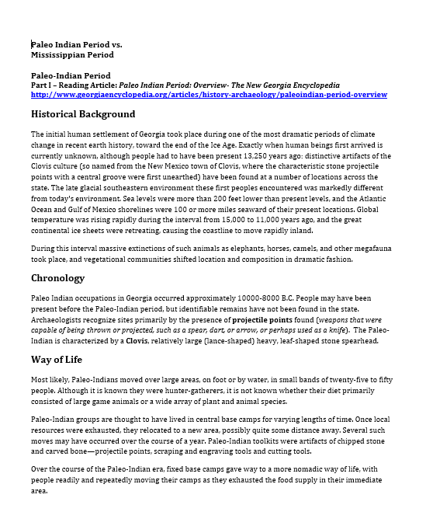
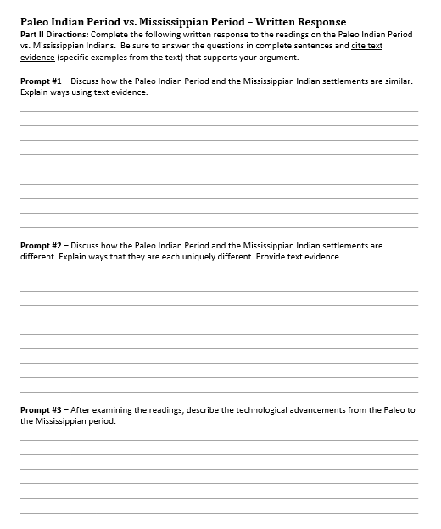
Assignment

Slide 10
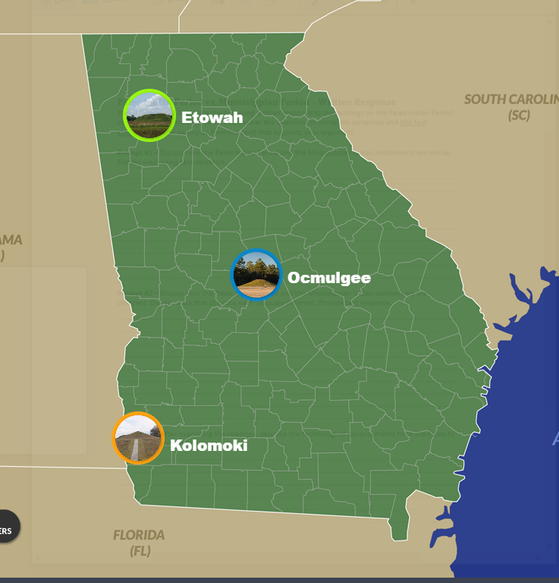
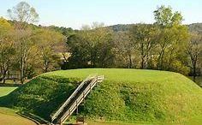
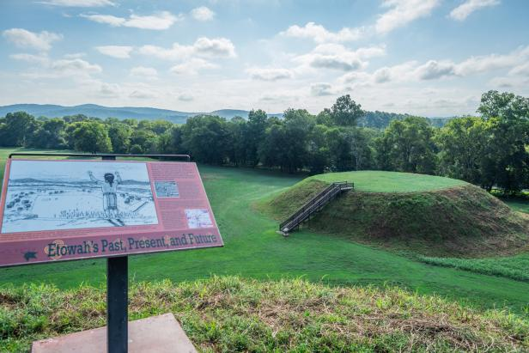
Notes:
Virtual Field Trip-https://www.gpb.org/ga-digital-textbook/#/en/issue/9E3B4BA9BAB5CE4CE3B46B854C323FFD/read/1

Slide 11
Closing
Write three exam
questions based on
your learning today.

