Slide 1
Geography of Georgia Unit 1 Week 3

Slide 2
Weekly Standard:
Learning Target:
Students will be able to distinguish among the five geographic regions of Georgia and locate key physical features.
SS8G1 Describe Georgia’s geography and climate.
b. Distinguish among the five geographic regions of Georgia in terms of location, climate, agriculture, and economic contribution.
C. Locate key physical features of Georgia and explain their importance; include the Fall Line, Okefenokee Swamp, Appalachian Mountains, Chattahoochee and Savannah Rivers, and barrier islands.

Slide 3
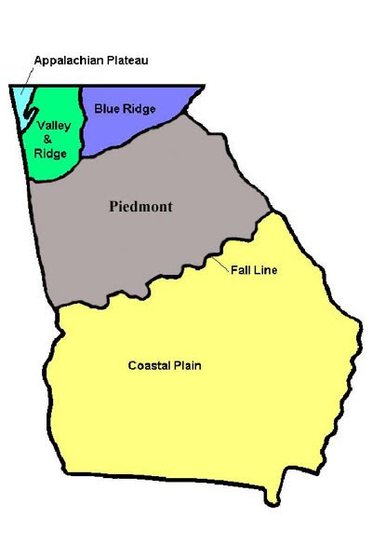
Learning Target:
I can describe Georgia’s Geography and Climate
I can locate Georgia in relation to region, nation, continent, and hemispheres.
I can distinguish between Georgia's regions by climate, agriculture, and economic contribution
I can locate key physical features in Georgia and describe their importance to Georgia’s development.
I can analyze the importance of water in Georgia’s economic growth

Slide 4
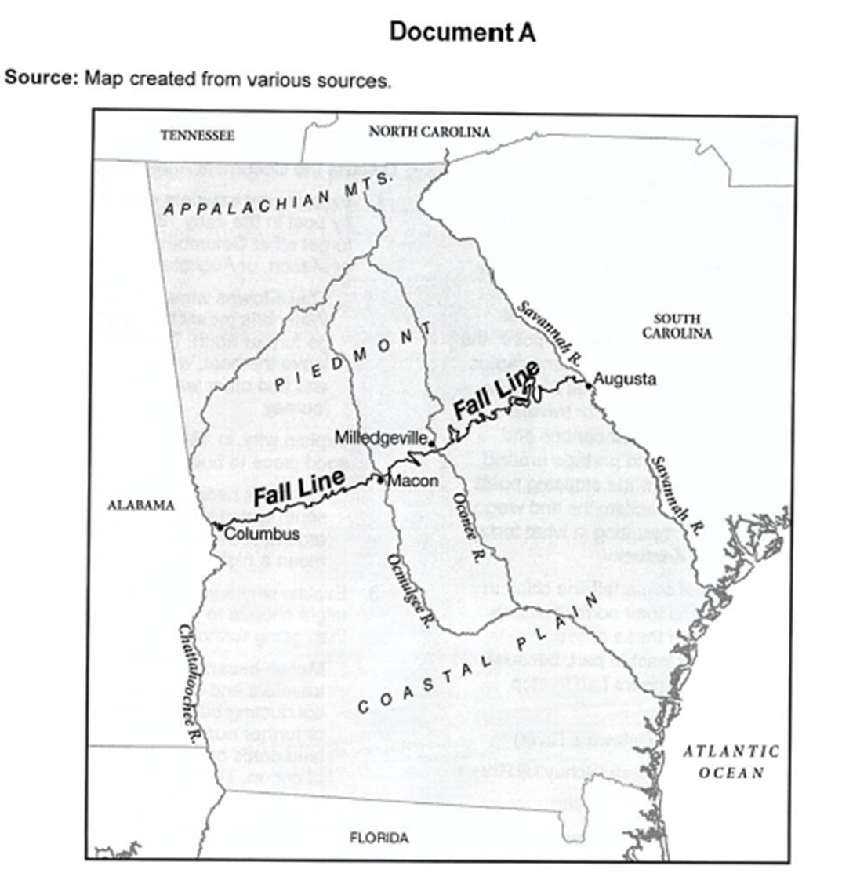
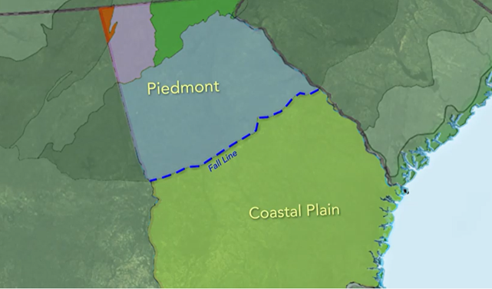
Week 3 Day 1 (3-1)
Why Were Early Georgia cities located on the fall line?
https://www.youtube.com/watch?v=QCDR4a8GlNI
Notes:
Students will use inference to answer the question- Why were Early Georgia cities located on the fall line?
https://www.youtube.com/watch?v=QCDR4a8GlNI
After watching the video, ask the question again.
This will cover
SS8G1 Describe Georgia’s geography and climate.
d. Analyze the importance of water in Georgia’s historical development and economic growth.

Slide 5
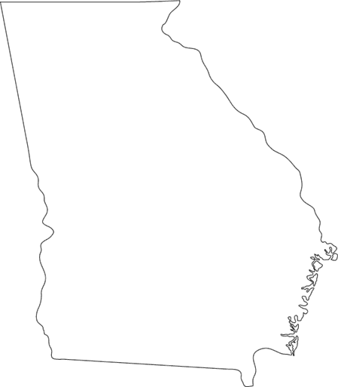
Classwork
DATE
ESSENTIAL QUESTION:
WHY ARE PHYSICAL FEATURES IMPORTANT TO GEORGIA’S DEVELOPMENT?
Fall Line, Okefenokee Swamp, Appalachian Mountains, Chattahoochee and Savannah Rivers, and barrier islands

Slide 6
Map of Physical Features
STEP 1: DRAW A GEORGIA MAP IN THE CENTER OF THE PAGE
STEP 2: DRAW THE FALL LINE
STEP 3: LABEL AND DESCRIBE THE IMPORTANCE OF THE BEAUTIFUL PHYSICAL FEATURES OF GEORGIA ON YOUR MAP.
Notes:
Help students correctly identify the physical features on their map

Slide 7
Virtual Field Trip
Notes:
https://www.gpb.org/ga-digital-textbook/#/en/issue/A1191A38A3E22DABBB530728BDC3052A/read/1
Whole Class instruction- Students will take notes on the map they created in their notebooks.

Slide 8
Summative Assessment Due: Friday, September 4th
Notes:
Describe the project and how to upload the assignment. DUE FRIDAY SEPTEMBER 4

Slide 9
Closing (3-1)
Give me one physical feature of Georgia and explain why it’s important to Georgia’s Development?

Slide 10
Week 3 Day 2 (3-2)
Notes:
https://create.kahoot.it/details/georgia-geography/80b6f849-fdea-4edd-b821-a02e88fa9575

Slide 11
FORMATIVE ASSESSMENT
CTLS Constructed Response

Slide 12
Remember: Summative Assessment Due Friday, September 4th
Notes:
Remind Students that the project is DUE FRIDAY SEPTEMBER 4- Give class time to complete project

Slide 13
Closing
TWEET ME!

