Slide 1
Geography of Georgia Unit 1 Week 2 Please get your notebook and a pen

Slide 2
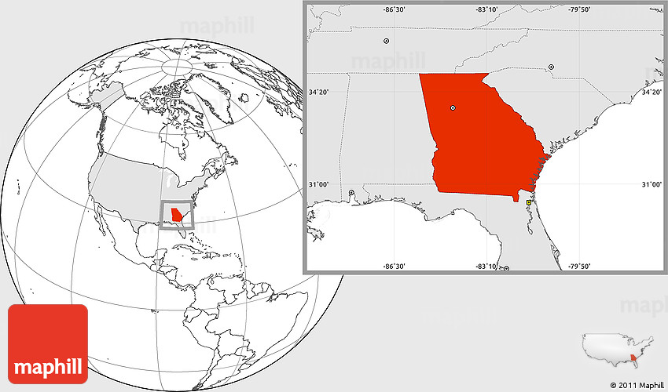
Standards
SS8G1 Describe Georgia’s geography and climate.
b. Distinguish among the five geographic regions of Georgia in terms of location, climate, agriculture, and economic contribution.
c. Locate key physical features of Georgia and explain their importance; include the Fall Line, Okefenokee Swamp, Appalachian Mountains, Chattahoochee and Savannah Rivers, and barrier islands.

Slide 3
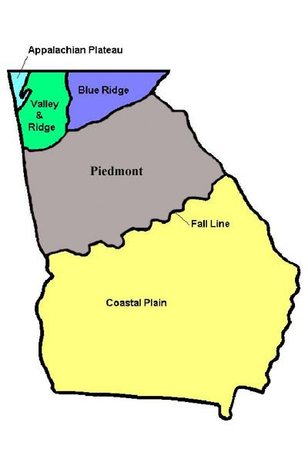
Learning Target:
I can describe Georgia’s Geography and Climate
I can locate Georgia in relation to region, nation, continent, and hemispheres.
I can distinguish between Georgia's regions by climate, agriculture, and economic contribution
I can locate key physical features in Georgia.
I can analyze the importance of water in Georgia’s economic growth

Slide 4
Week 2 Day 1 (2-1)
WHERE IN THE WORLD IS GEORGIA?
REGION?
NATION?
CONTINENT?
HEMISPHERES?
Date
Learning Target:
Introduction:
Notes:
Notes:
Quick informal assessment (part of opening)

Slide 5
Week 2 Day 2 (2-2)
Please have your notebook and a pen ready for today’s class.
QUICK REVIEW
Notes:
Opening- Review Regions

Slide 6
Tomorrow’s Learning Support session
10:00 – 11:00 (Optional)
Where is Georgia in the world?
5 Regions of GA
Understanding the whiteboard.fi formative assessment

Slide 7
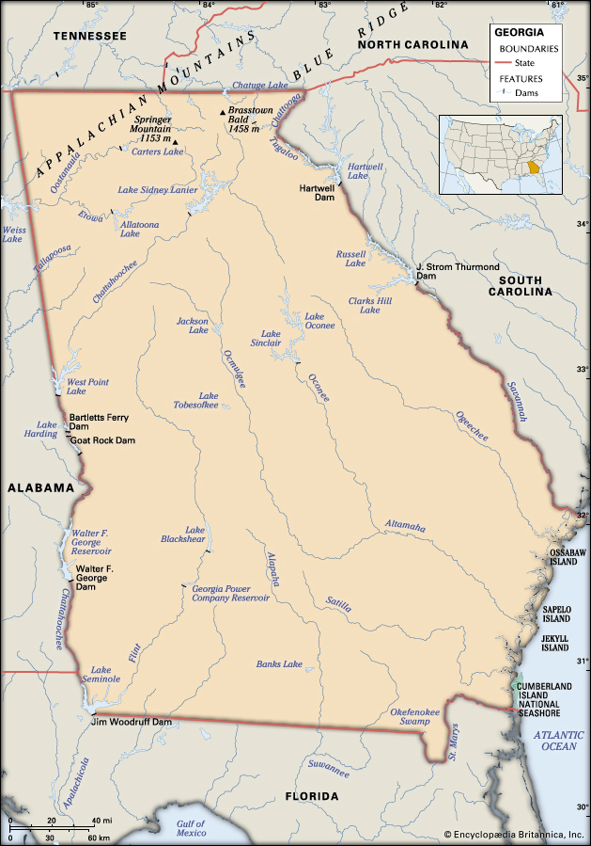
Georgia Geography
What is Geography?
What Can you do with Geography?
Georgia Geography
Notes:
Opening to class (play any or all videos)
Students should take notes

Slide 8
Click the link to the right and follow the prompts
Read the Quick Glance, Read and Explore each Region and complete the Region Review Activities in the Challenge Section.
Notes:
Whole class (Day 1) Model Georgia virtual website with students.
https://learning.elucidat.com/course/59dc1fa66e749-59dc2a520227e

Slide 9
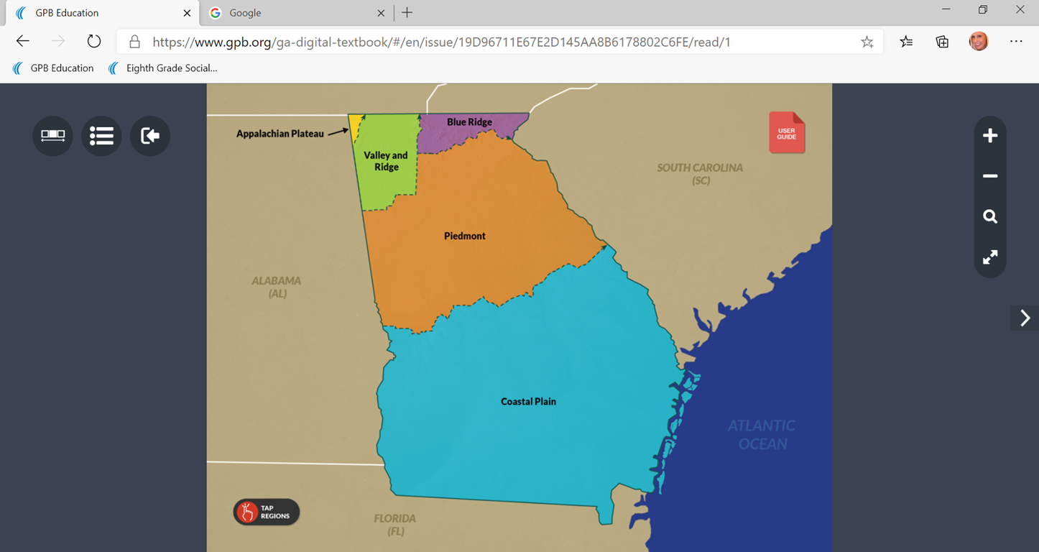
Click on the link in the photo. As you Explore the regions of Georgia, complete the following IN YOUR ss NOTEBOOK;
Cite text evidence on your map based on the passage to examine specific regional characteristics.
1 sentence from the text for each region with an explanation
1 phrase from the text for each region with explanation
1 descriptive word from the text for each region with explanation
Notes:
https://www.gpb.org/ga-digital-textbook/#/en/issue/19D96711E67E2D145AA8B6178802C6FE/read/1
Student Led activity in class (HW)

Slide 10
Formative Assessment – Due by end of day Friday
Choose one of the five regions to write a paragraph about.
Name the region.
Where is the region located in Georgia? (Use your Cardinal Directions to locate region)
What is the climate in this region?
What crops are grown in this region?
What makes up the economy in this region?
What physical features and cities can be found in this region?
Why would somebody want to visit this region of Georgia?

Slide 11
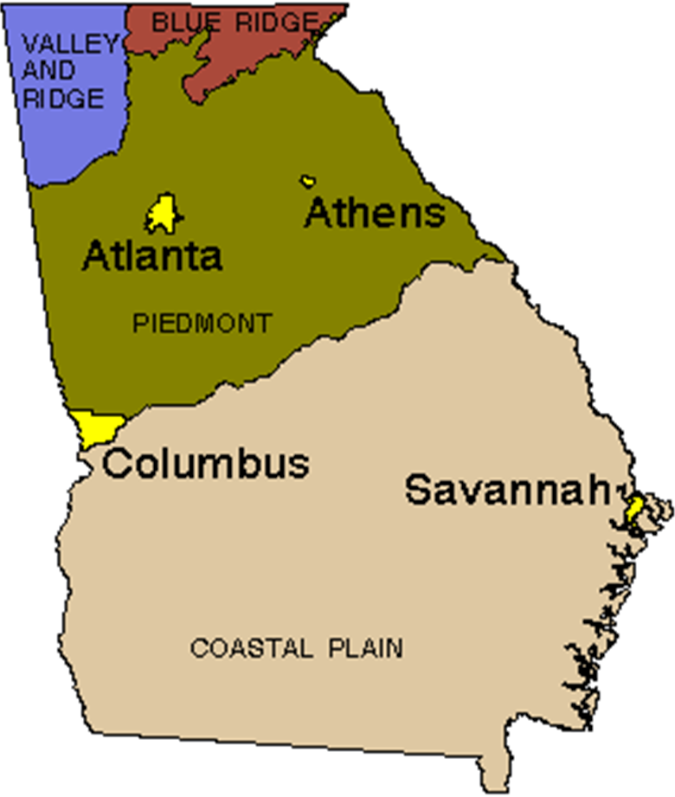
Georgia Regions video links
PIEDMONT
COASTAL REGION
BLUE RIDGE MOUNTAINS
VALLEY AND RIDGE
APPALACHIAN PLATEAU
Notes:
Supplemental videos

Slide 12
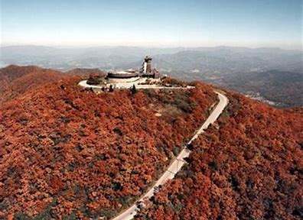
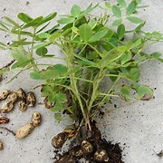
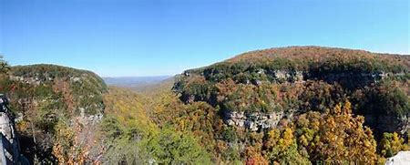
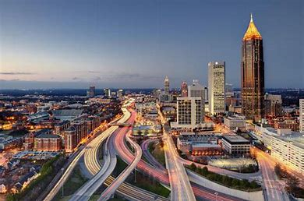
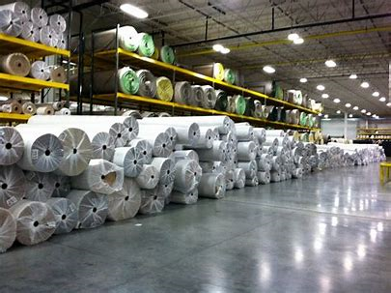
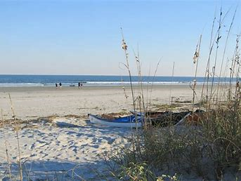
Warm up
What do you see? Why is it relevant? What region is it?
1
3
2
5
4
6
Notes:
Further review regions

Slide 13
What benefits might these physical features have?

Slide 14
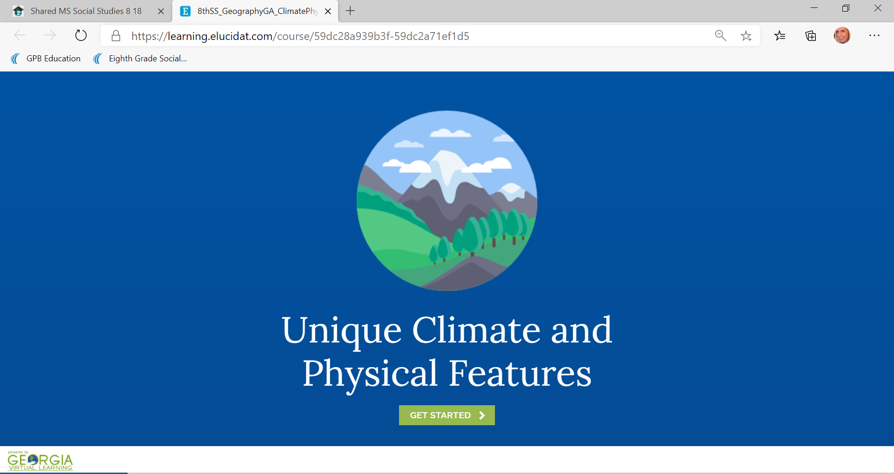
As You EXPLORE THE Unique climate and Physical Features in Georgia COMPLETE THE FOLLOWING in your Social Studies notebook
Create a mind map to explain the importance of key physical features.
1 piece of text evidence per feature
1 explanation of what the evidence means
1 explanation about why the feature matters/importance of the features
Notes:
https://learning.elucidat.com/course/59dc28a939b3f-59dc2a71ef1d5
Day 2

Slide 15
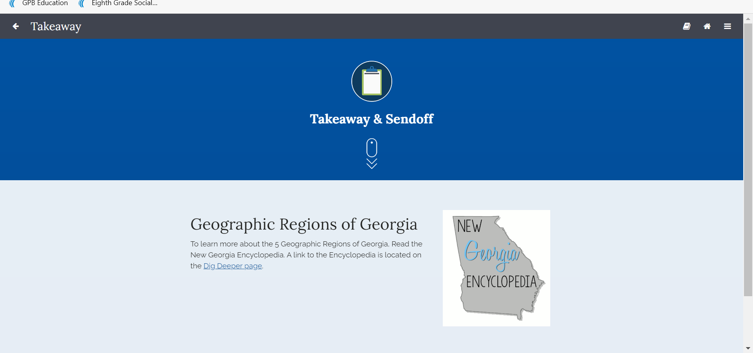
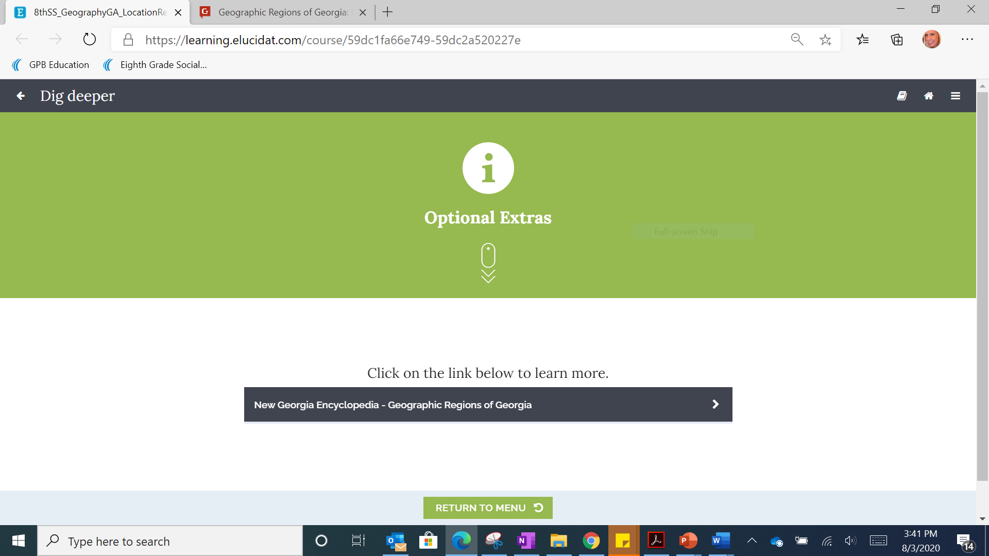
CLICK DIG DEEPER
CLICK the link in the black box
Notes:
Additional Reading for Project
Link to the Reading-
https://georgiainfo.galileo.usg.edu/topics/geography/article/geographic-regions-of-Georgia

