Slide 1
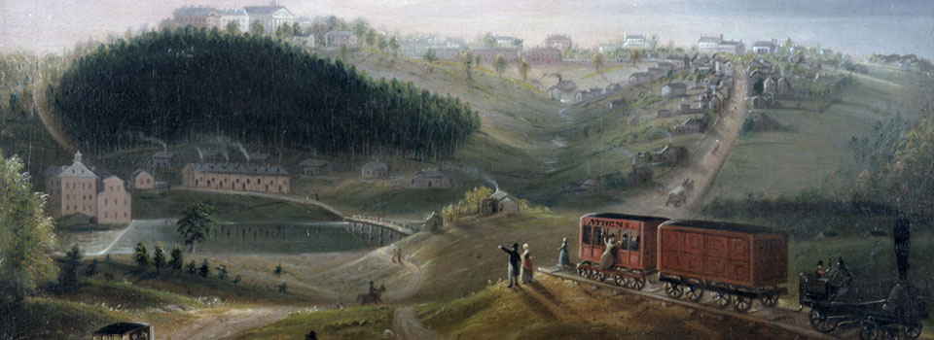
Introduction
Title your notes: UGA and Westward Movement – 11/16/2020
After the American Revolution, Georgia began to turn its attention to growth and development and expansion into its vast western frontier. In your journal:
  Write 3 things you notice about this painting.
  What influences people to move from one place to another?
  What does the end of the railroad represent?

Slide 2
Weekly Standard & Learning Target
Weekly Standard
Learning Target
SS8H4 Explain significant factors that affected westward expansion in Georgia between 1789 and 1840.
a. Explain reasons for the establishment of the University of Georgia, and for the westward movement of Georgia’s capitals.
I can explain reasons for the establishment of the University of Georgia, and for the westward movement of the Capitals.

Slide 3
Quote Analysis
The charter asserted that an educated citizenry is essential to a free government, that government has a responsibility to see that its citizens receive an education, and that all people — not just the wealthy and privileged — have a right to education. Larry B. Dendy
Why does government have a responsibility to provide citizens with a free education?
Who should receive an education?
What charter do you think is being referred to in this statement?

Slide 4
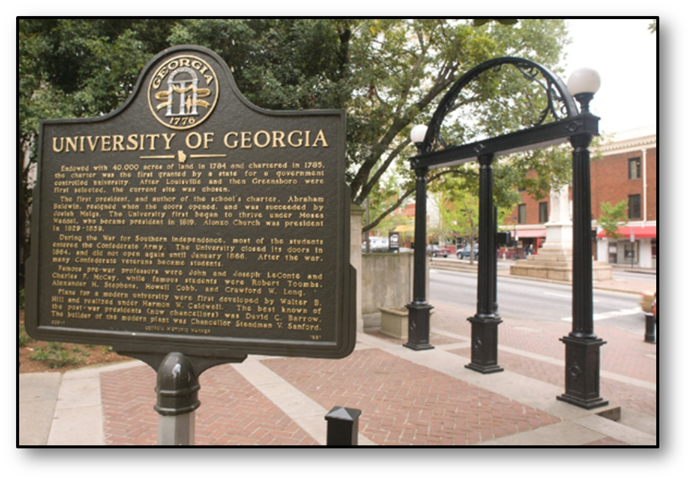
In 1784, Georgia’s legislature, the General Assembly, set aside
40,000 acres of land for the University of Georgia.
The man selected to write the charter for the University was Abraham Baldwin, one of GA’s two signers of the Constitution!
UGA is America’s FIRST public University
Georgia was a pioneer in public education. The University’s charter was
approved in 1785, and Abraham Baldwin was named the school’s first President.
Originally called Franklin College in honor of Benjamin Franklin, it ultimately became the University of Georgia and opened its doors in 1801.
Notes:
The original 40,000 acre land grant was sold, and the school was built in 1801, in Athens, on land donated by then
Gov. John Milledge.
Supplemental Video:
https://www.gpb.org/georgiastories/stories/abraham_baldwin
https://www.todayingeorgiahistory.org/content/university-georgia-chartered

Slide 5


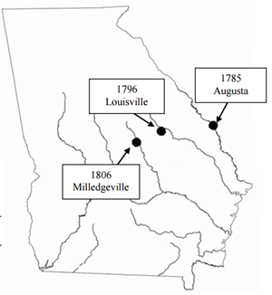
The map to the left shows changes in Georgia’s capital cities from 1785 to 1806.
Where did Georgia’s capital move in 1796?
Why were there changes in the location of Georgia’s capital cities?
What do you notice about the location of all of Georgia’s capitals? Explain.
S
A
L
M
A
Notes:
Instructional Approach: Start with allowing students to answer the 3 questions. This graph will help students explain the movement of Georgia’s capital over the years. As a part of each explanation, give the time period (write on the arrow) of each capital and why the capital was moved to its new location.

Slide 6
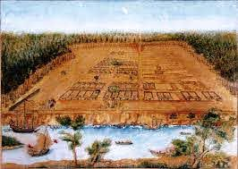
Savannah
(1732-1784)
Savannah was Georgia’s first capital. It was named after the Savannah River.
By 1785, the population center of GA had moved to the backcountry and the capital was moved to Augusta.

Slide 7
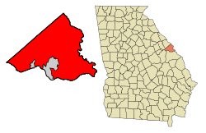
Augusta
(1785-1795)
Augusta became Georgia’s state capital in 1785, but the state legislature wasn’t satisfied with the location.
It commissioned a group to find a location further west that would be a more central location for trade.

Slide 8
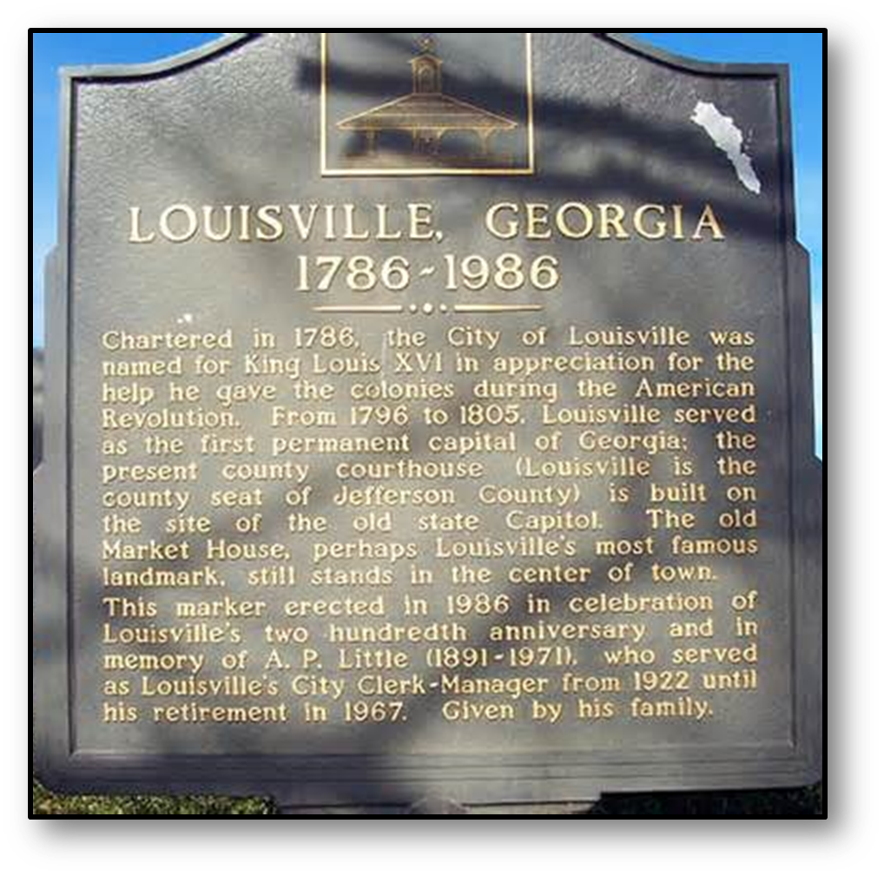
Louisville
(1796-1806)
Louisville was named to honor France’s King Louis XVI for his support during the American Revolution.
Even though the site was selected, it took over ten years for the government to move there in 1796. Eventually, western expansion and an outbreak of malaria in Louisville caused state officials to move the capital again.

Slide 9
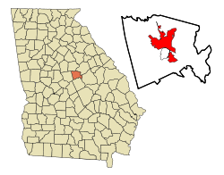
Milledgeville
(1806-1867)
In 1806, the capital was, once again, moved west to keep up with the population migration, to a new site along the Oconee River, Milledgeville. The capital remained there for 60 years. The new capital city of Georgia was named Milledgeville in honor of Gov. John Milledge who had donated the land to build UGA.

Slide 10
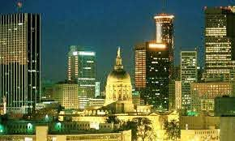
Atlanta
(1868-Present)
Eventually the state Capital was moved to Atlanta, Georgia. Atlanta started as a railroad hub called Terminus. Later called Marthasville, and finally renamed Atlanta. The MAIN reason the capitals moved WEST was to help keep the capitals in the center of the state’s population.

Slide 11
Answer the questions in complete Sentences
What was significant about the establishment of the University of Georgia?
Why did Georgia’s capitals move away from its original location in Savannah and where did it go?
Class Discussion

Slide 12
Closing: True or False – make the false statements true!
The capitals in Georgia continuously moved because they were built in Low-lying areas.
An outbreak of malaria in Louisville caused state officials to move the capital again in 1804.
Milledgeville Served as the capital for over a 100 years.
By 1785, the population center of GA had moved to the backcountry and the capital was moved to Augusta.
The first public, land-grant institution of higher learning in U.S. history was Georgia Tech.
The author of the charter for the University of Georgia was Button Gwinnett.

