Slide 1



Journal Prompt: In a paragraph answer the following question:
Is technology always positive for society or are there unintended consequences of those technological developments? Give an example.

Slide 2
Weekly Standard & Learning Target
Weekly Standard
Learning Target
SS8H4 Explain significant factors that affected westward expansion in Georgia between 1789 and 1840.
c. Explain how technological developments, including the cotton gin and railroads, had an impact on Georgia’s growth.
I can explain how technological Developments, including the cotton gin and railroads, had an impact on Georgia's growth.

Slide 3
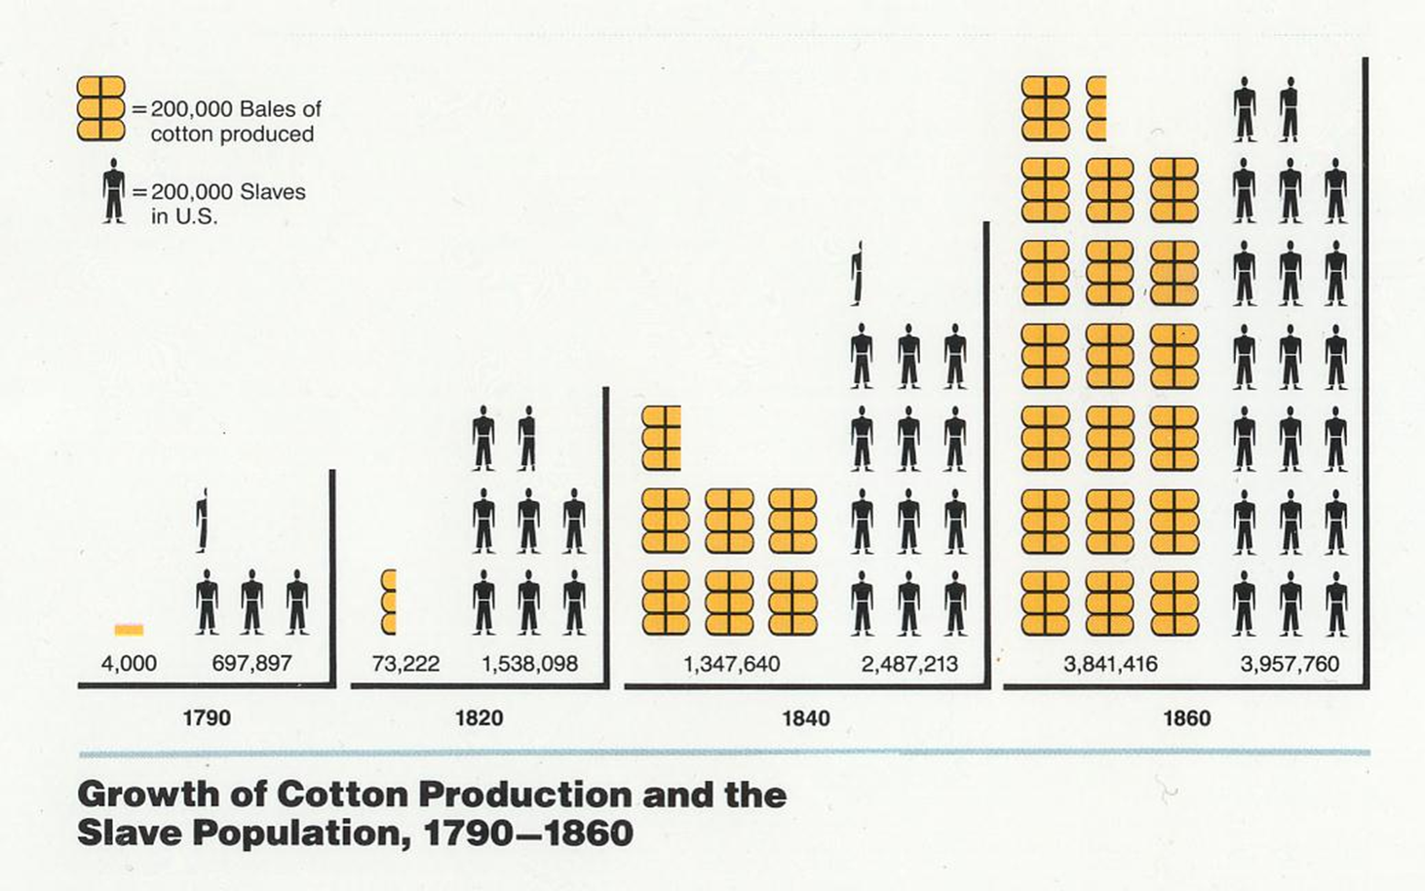
Cotton Gin
Draw conclusions and make generalizations
Notes:
https://video.gpb.org/video/georgia-stories-king-cotton-and-cotton-gin/
Instructional Approach: Analyze the graph of cotton production- Have students draw conclusions and make generalizations.

Slide 4
Cotton & Questions
https://video.gpb.org/video/georgia-stories-king-cotton-and-cotton-gin/
1. How many slaves were there in Georgia in 1790? In 1860?
2. Where was cotton first grown in Georgia? What was it called?
3. How were cotton seeds originally removed from cotton?
4. How long did it take to remove the seeds by hand to get one pound of cotton?
5. Who invented the cotton gin? When?
6. How many times more cotton could the cotton gin produce than a person could by hand?
7. Why did the invention of the cotton gin increase the need for slaves?
8. What were the slaves needed for in cotton production?
9. What benefits were provided by the cotton gin? What harm was caused?

Slide 5
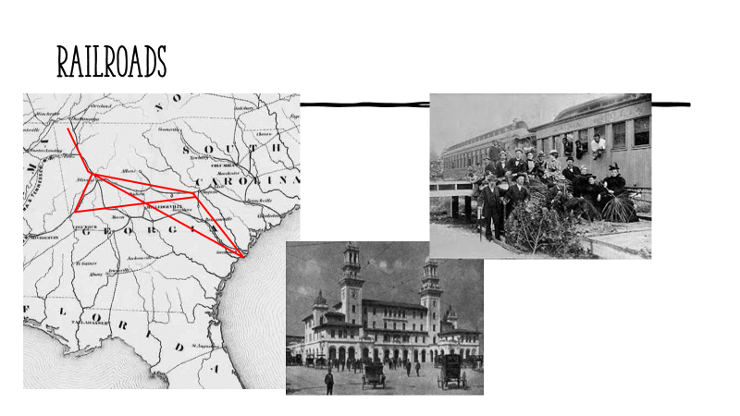

Slide 6
Railroads & Questions
https://www.gpb.org/georgiastories/stories/railroads_economic_boom
1. What were the major methods of travel in the early 1800s before the railroad was built?
2. What was the most difficult problem with roads at the time?
3. What invention made travel on waterways easier?
4. What country first tried to apply steam power to rails?
5. When and where was the first railroad built in the Southeast? How long was it? Why did people in Savannah see the
railroad as a potential problem?
6. When and where was the first railroad built in Georgia?
7. What made passenger trains uncomfortable in that day?
8. What names were given to the main railroad center in Georgia?

Slide 7
Closing
Written Response – In your journals, explain the unintended purpose and the unintended consequences for the cotton gin and the railroad system for Georgia. Use evidence from your learning to support your answer.

