Slide 1
American Revolution – 11/10/20
In your notebook, write down and answer the following question:
  Were most Georgia citizens Tories or Patriots? Why?

Slide 2
Weekly Standard & Learning Target
Weekly Standard
Learning Target
SS8H3 Analyze the role of Georgia in the American Revolutionary Era.
c. Analyze the significance of the Loyalists and Patriots as a part of Georgia’s role in the Revolutionary War; include the Battle of Kettle Creek and Siege of Savannah.
I can analyze the significance of the Loyalists and Patriots as a part of Georgia's role in the Revolutionary War in the Battle of Kettle Creek and the Siege of Savannah.

Slide 3
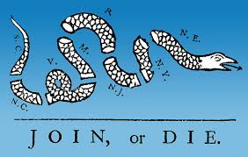
Loyalist vs. Patriot
  Both before and during the American Revolution, Americans had to make a difficult choice as to which side to take in the events surrounding the relationship between England and the American Colonies.
  Americans had to decide if they were committed to the idea of self-government or if they wanted to remain loyal to the King. This decision at times tore apart friends and families.
Notes:
Supplemental Video: https://www.youtube.com/watch?v=nhYUyniqWlo

Slide 4
Most citizens of Georgia were Tories (also called Loyalists, because they were loyal to
King George III). Many agreed to fight in the British Army.
A smaller group of colonists became Whigs (also known as Patriots); they wanted independence from Great Britain.
* It may help you remember the Whigs from the Tories if you think of American Whig & General, George Washington, who famously
wore a wig.
Notes:
At the start of the Revolutionary War, Georgia was divided into two factions:

Slide 5
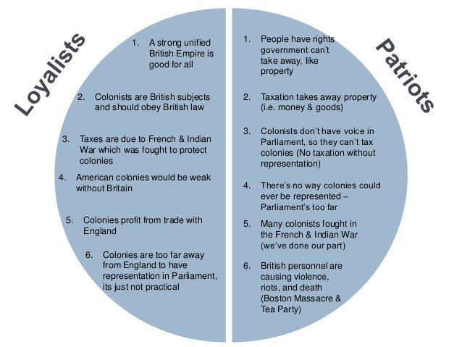
Notes:
Instructional Approach: Supplemental notes for those students who need more understanding.

Slide 6
The Revolutionary War In Georgia
- Most Georgia Patriots lived in Georgia’s frontier
backcountry . They tended to rely on themselves and did not want to be bothered by the government.
- Most Georgia Loyalists lived along the coast, in or around Savannah. They were wealthy and benefited from their trade relationship with England.

Slide 7
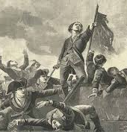
Class Activity
 | Battle Kettle Creek | Siege of Savannah
When did it happen?
Who was involved?
Where did it happen?
What happened?
Notes:
Instructional Approach: Watch the video and allow students to gather evidence on the Siege of Savannah. Have the Students read (See worksheet in lesson plan) about the Battle of Kettle Creek/Siege of Savannah to gather evidence on that particular battle.
Supplemental Websites:
https://www.history.com/this-day-in-history/patriots-defeat-loyalists-at-kettle-creek
https://kettlecreekbattlefield.com/the-battle-of-kettle-creek/

