Slide 1
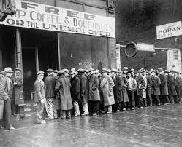
Learning Target - I can explain economic factors that resulted in the Great Depression. (e.g., boll weevil and drought).
In your notebook: What do you think of when you hear “The Great Depression”?

Slide 2
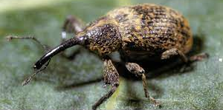
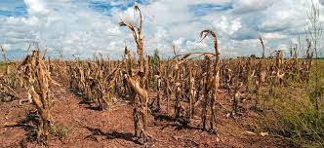
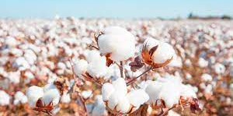
Today’s Standard
SS8H8 Analyze Georgia’s participation in important events that occurred from World War I through the Great Depression
b. Explain economic factors that resulted in the Great Depression. (e.g., boll weevil and drought).

Slide 3
What is “Depression”?
An economic depression is when a country is dealing with a serious financial downfall, or economic downturn. The production of items is low, and business slows for many companies. With production down and business slow, the job market also begins to suffer. During an economic depression, there are usually a lot of failed businesses and a high unemployment rate.
Imagine a place where there's not enough food for everyone. Imagine standing in line just to receive a few potatoes to feed your whole family or traveling from town-to-town just to try and find a job. The place you just imagined could be a country in economic depression.

Slide 4
Work Session
Online Students –
Either go to the lesson resources in CTLS for today or my blog (burgergastudies.weebly.com) and Download and Save As the following documents:
SS8H8 Reading
SS8H8 Guided Questions
Please make sure you are saving the guided questions document as you go, since we will be working on it more this week.

Slide 5
Closing
In a few sentences, answer the following question:
Given what you learned about economic depression and the examples, do you believe we are currently in an economic depression? Explain why you believe we are or are not in an economic depression using examples that compare and contrast the situations today with the situations from the 1920s.

