Slide 1
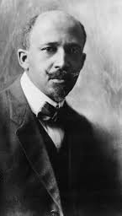
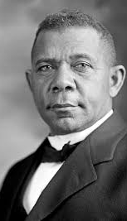
Learning Target - I can explain the roles of Booker T. Washington and W.E.B. DuBois in the advancement of the rights of African Americans.
Read the following quote: “The slave went free; stood a brief moment in the sun; then moved back again toward slavery.”
Answer in Your Notebook: What does this quote show us about history in the south?

Slide 2
Reminder – Unit 5 Summative Tomorrow!!!
Unit 5 Summative Quizlet is up on the home page of my blog (burgergastudies.weebly.com)

Slide 3
Booker T. Washington vs W.E.B. DuBois
While watching the two videos, create a T-Chart to compare/contrast the ideas of both men. How were their views similar and different?
https://www.youtube.com/watch?v=qGLm7VUbIWE
https://www.youtube.com/watch?v=HaLstb_t8yc
Booker T. Washington | W.E.B. DuBois

Slide 4
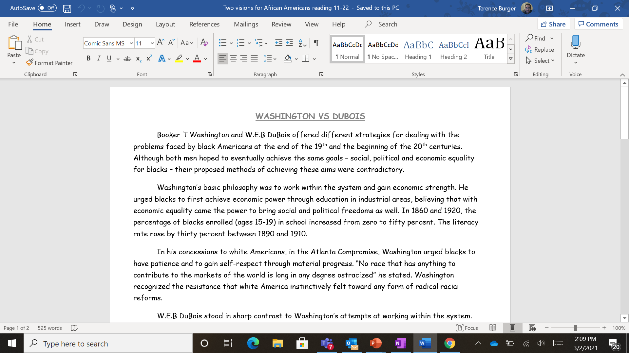
Work Session
CTLS Lesson Resources or my blog (burgergastudies.weebly.com)
“Two Visions for African Americans Reading”
Make sure to Save As and Enable Editing, so that you can write on the Word Document.

Slide 5
Closing
Debate: Who do you think had the better view of how African Americans should try to gain equality?

