Slide 1
Learning Target - I can explain the impact of Maynard Jackson and Andrew Young on the state of Georgia
Answer in your Notebook – Describe to somebody from outside of Georgia, what Georgia is famous/known for today.

Slide 2
Maynard Jackson & Andrew Young
In your notebook, make a T-Chart that looks like this:
Maynard Jackson
Andrew Young

Slide 3
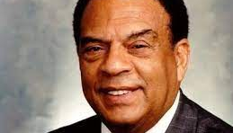
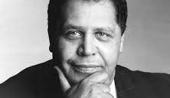
Maynard Jackson & Andrew Young Videos
Maynard H. Jackson becomes the first black Mayor of Atlanta, Georgia – YouTube
Ambassador Andrew J. Young: A Civil Rights Hero - YouTube

Slide 4
Work Session
SS8H12 Reading & Unit 9 Note Sheet
Both can be found in the lesson resources of CTLS and my blog.
I will do guided reading about Maynard Jackson and Andrew Young, and you will complete the first two boxes in the note sheet.

Slide 5
Closing
Vocabulary Term (Define in your own words) | Description | Connections Explain its connection, its impact on GA, and/or the “big picture”.
Maynard Jackson as Mayor of Atlanta | Information/Notes (5 W’s and H): | What impact did Maynard Jackson have on the Civil Rights movement in Georgia? Why, in your opinion, was Atlanta’s airport renamed after Maynard Jackson’s death?
Andrew Young | Information/Notes (5 W’s and H): | What impact did Andrew Young have on Georgia during the modern Civil Rights movement?

