Slide 1
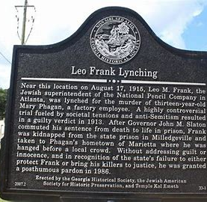
March 2, 2021 Learning Target: I can examine Anti-Semitism and the resistance to racial equality exemplified by the Leo Frank Case.
In your notebook, answer the following question: Who do you think is guilty of the murder of Mary Phagan? Why?

Slide 2
Unit 5 Summative
This Friday!!!

Slide 3
Work Session
Watch “The People vs Leo Frank”
The People Vs. Leo Frank – YouTube
In Today’s Lesson Resources in CTLS, find and work on:
Leo Frank: For & Against Comparison
Leo Frank Movie Questions
Make sure that you Save As and Enable Editing, so that you can answer the questions.

Slide 4
Closing
What are your thoughts so far about the Leo Frank Case?
Do you think he is guilty or innocent?

