Slide 1
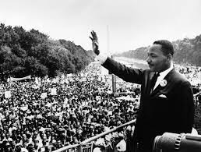
Learning Target - I Can… Describe the role of (people) King and Lewis; (groups) SNCC and SCLC; and (events) Albany Movement and the March on Washington in the modern Civil Rights movement.
Answer in Your Notebook: In what year did Georgia change its state flag to include the Confederate flag? What was this in response to?

Slide 2
Mark in Your Agenda
Summative Test – Monday, March 29th!!!

Slide 3
Video
March on Washington
History Specials: King Leads the March on Washington | History - YouTube
Remembering John Lewis
Remembering the tenacious John Lewis - YouTube

Slide 4
Work Session
We will continue to work on SS8H11 Reading and Questions

