Slide 1
Trail of Tears DBQ Documents Analysis
Insert Name Here

Slide 3
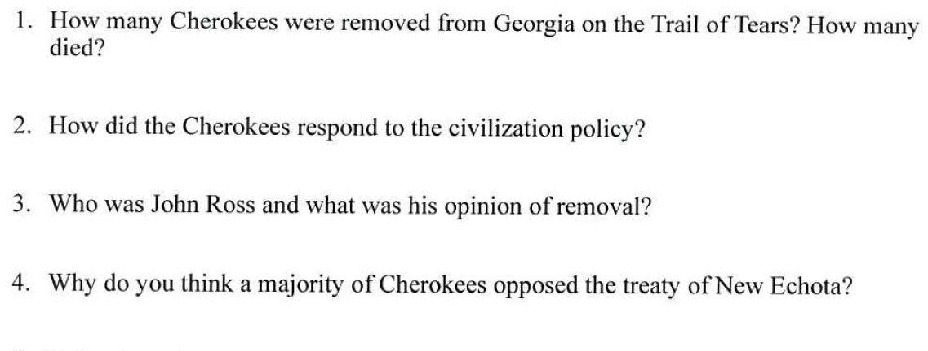
Background Essay
Type response here
Type response here
Type response here
Type response here

Slide 4
5. Define these Terms:
Trail of Tears -
Politics -
Civilization -
Indian Removal Act -
Cede -
Social Prejudice -
Economies -

Slide 5
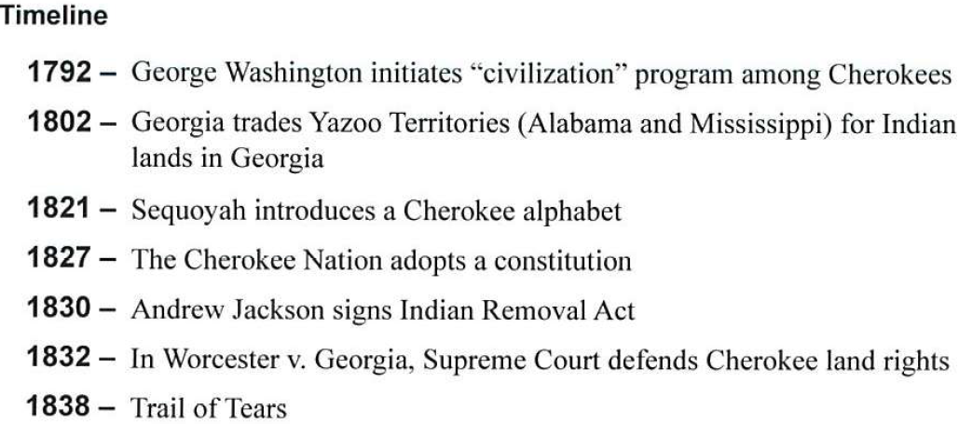

Slide 7
Type response here
Type response here
Type response here
Type response here
Type response here

Slide 8
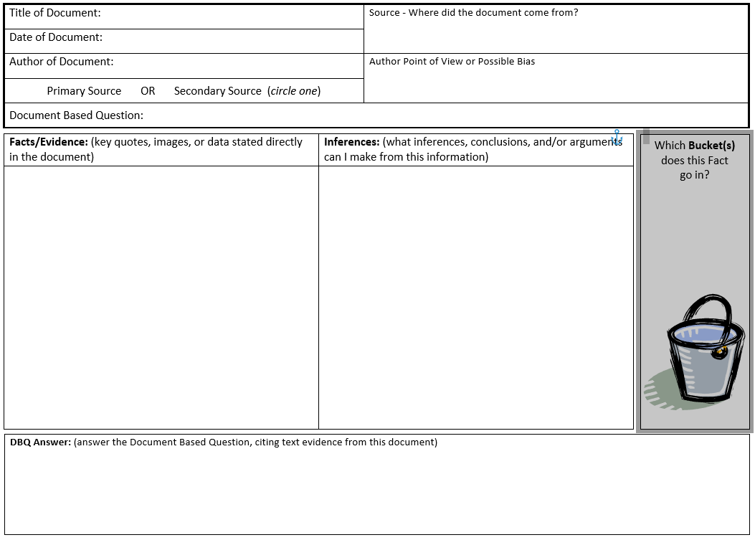
Type response here
Type response here
Type response here
Type response here
Type response here
Type response here
Type response here
Type response here
Type response here

Slide 10
Type response here
Type response here
Type response here
Type response here
Type response here

Slide 11
Type response here
Type response here
Type response here
Type response here
Type response here
Type response here
Type response here
Type response here
Type response here

Slide 12
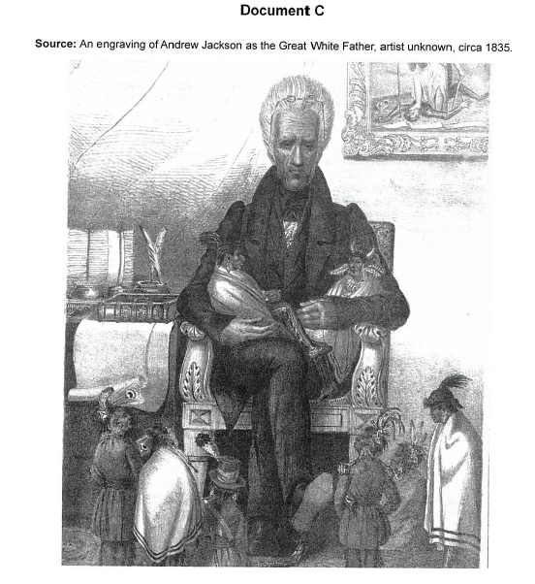

Slide 13
Type response here
Type response here
Type response here
Type response here
Type response here
Type response here

Slide 14
Type response here
Type response here
Type response here
Type response here
Type response here
Type response here
Type response here
Type response here
Type response here

Slide 15
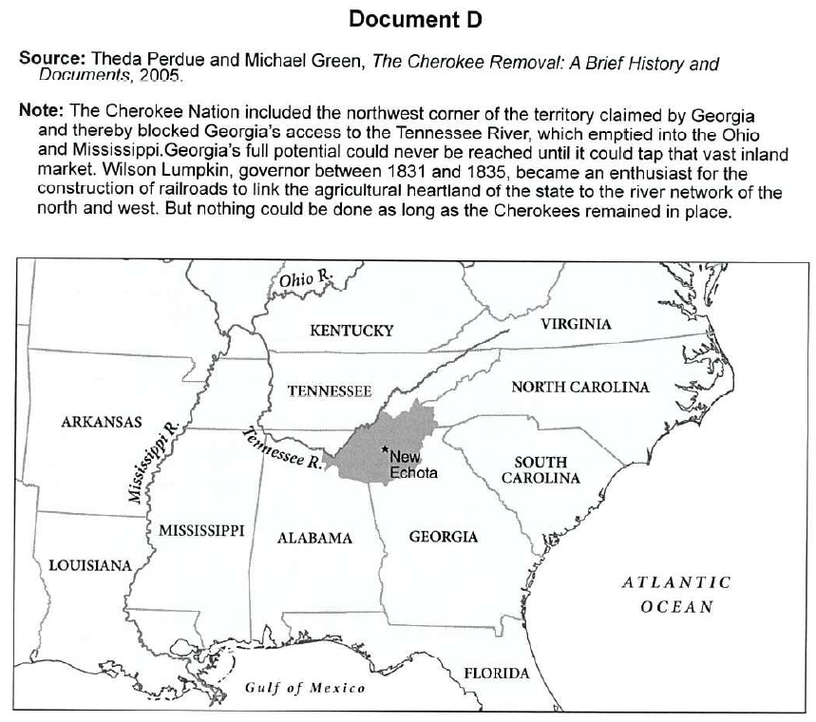

Slide 16
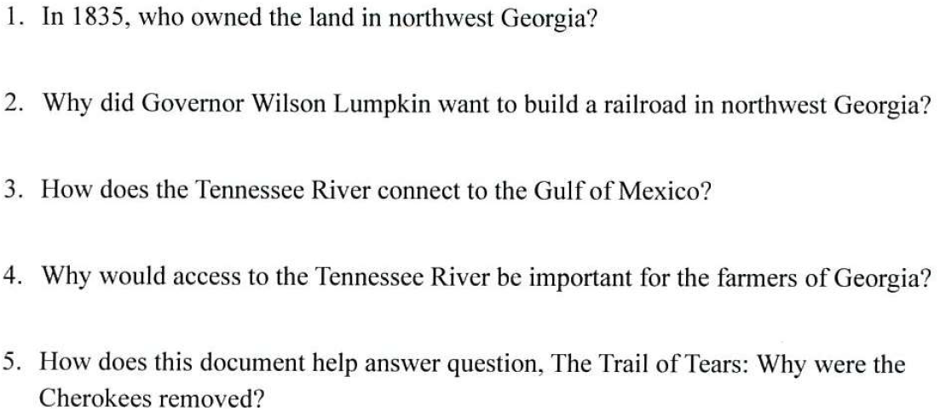
Type response here
Type response here
Type response here
Type response here
Type response here

Slide 17
Type response here
Type response here
Type response here
Type response here
Type response here
Type response here
Type response here
Type response here
Type response here

Slide 19
Type response here
Type response here
Type response here
Type response here

Slide 20
Type response here
Type response here
Type response here
Type response here
Type response here
Type response here
Type response here
Type response here
Type response here

