Slide 1
Have you completed every assignment?
GET OUT YOUR NOTEBOOK AND A PEN!

Slide 2
Regions of Georgia
Those that have sent me their Regions of Georgia:
Cristian A
Isabel C
Everybody else currently has a 0.

Slide 3
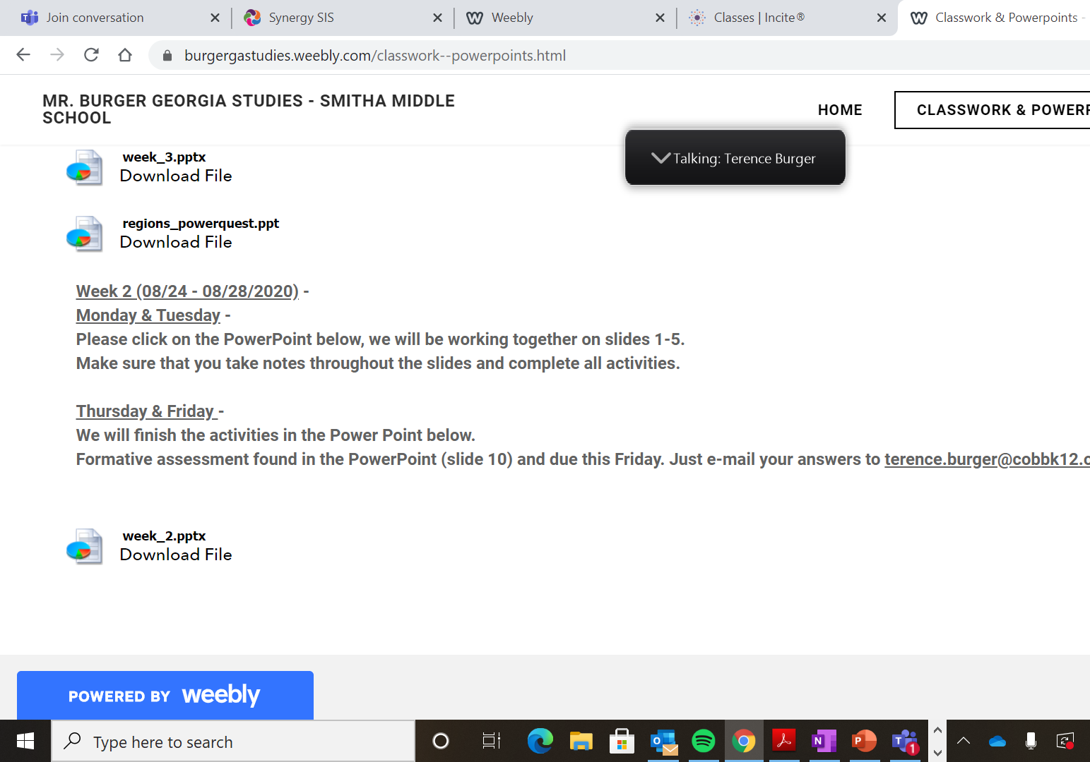
How to Get to Regions of Georgia
Go to my blog: burgergastudies.weebly.com
Click on “Week 2” PowerPoint and go to slide 10 for instructions.
E-mail me your response.

Slide 4
Regions of Georgia PowerQuest
Those that have sent me their Regions of Georgia PowerQuest:
Cristian A
Jenifer A
Isabel C
Everybody else currently has a 0.

Slide 5
How to Get to Regions of Georgia PowerQuest
Go to “Assignments” in CTLS or my blog: burgergastudies.weebly.com
E-mail me your PowerPoint
z

Slide 6
Georgia Regions Formative
If you did not complete the formative assessment that we did in class, I will be unpausing it.
TODAY IS THE LAST DAY TO COMPLETE!

Slide 7
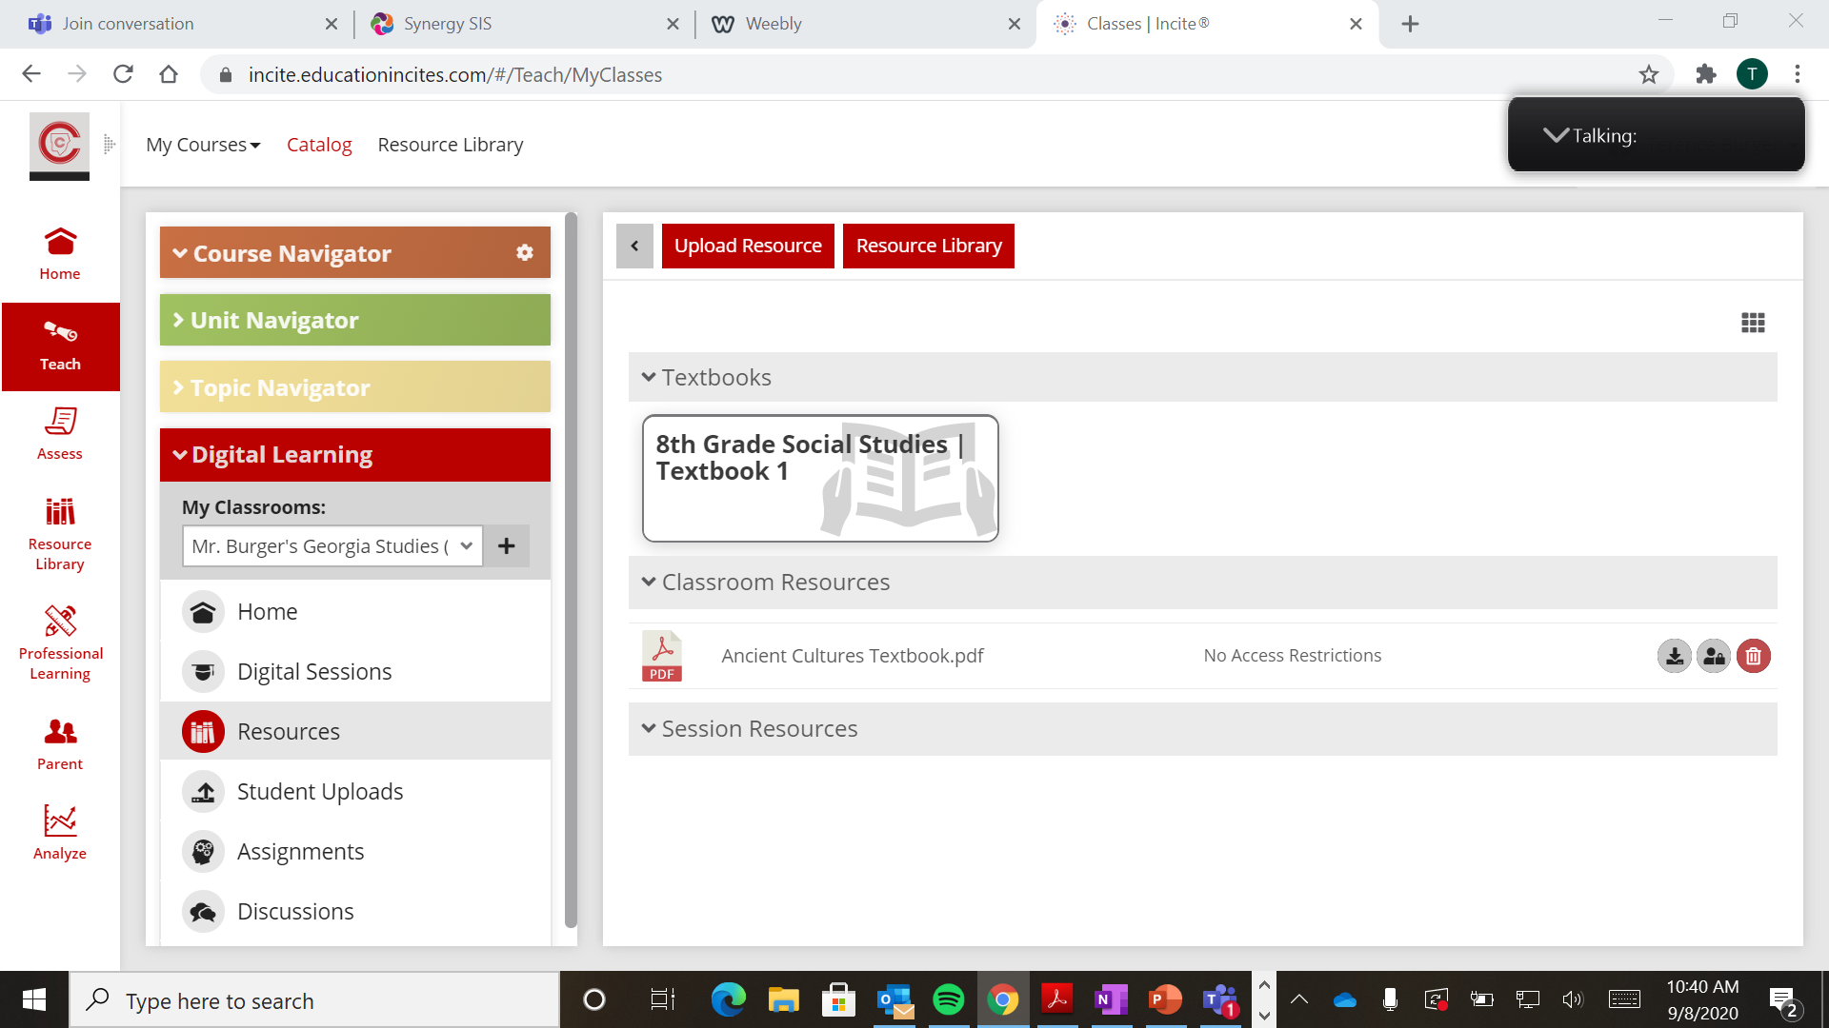
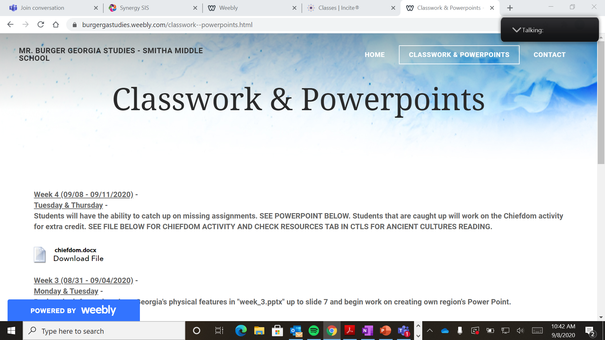
Extra Credit: IF YOU HAVE COMPLETED EVERYTHING.
Chiefdom Activity
Found on blog: burgergastudies.weebly.com
Reading for Chiefdom Activity found in Resources tab “Ancient Cultures Textbook”

Slide 8
REMINDER – PROGRESS REPORTS COME OUT ON FRIDAY!!!
z

