Slide 1
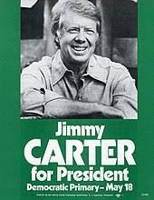
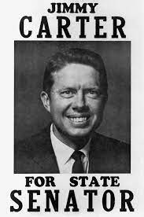
Learning Target - I can explain the role of Jimmy Carter as: 1.) Senator, 2.) Governor, and 3.) President.
Answer in Your Notebook: What important event did Maynard Jackson and Andrew Young help bring to Atlanta?

Slide 2
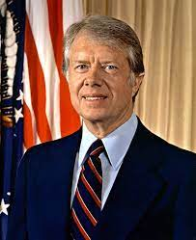
Jimmy Carter Video
Jimmy Carter - U.S. President | Mini Bio | BIO – YouTube
While watching, take notes on who he is and what his accomplishments are.

Slide 3
Work Session
SS8H12 Reading & Unit 9 Note Sheet
Both can be found in the lesson resources of CTLS and my blog.
I will do guided reading about Jimmy Carter and you will complete the third box on the note sheet.

Slide 4
Work Session
Jimmy Carter | Information/Notes (5w’s and H) | What impact did Jimmy Carter have while serving as Senator, Governor, President, and Past President?

Slide 5
Closing
1.) What were Jimmy Carter’s accomplishments (+) as state senator?
A.)
B.)
2.) What were Jimmy Carter’s accomplishments (+) as governor?
A.)
B.)
C.)
3.) What were Jimmy Carter’s accomplishments (+) as president?
A.)
B.)
4.) What were Jimmy Carter’s disappointments (-) as president?
A.)
B.)
C.)

